Slide 1
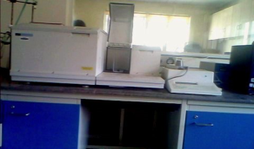
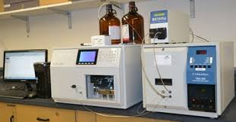
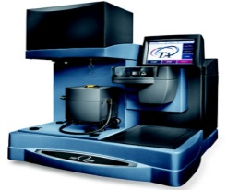
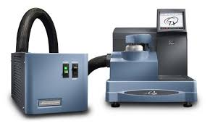
Polymer Characterisation by DSC, TGA
and GPC techniques
About course
Thermal Analysis and chromatography are used in a various industries like polymer, pharmaceutical, food, materials etc. Thermo Gravimetric Analysis (TGA), Differential Scanning Calorimeter (DSC) and Gel Permeation Chromatography (GPC) is the essential and important laboratory techniques used for material characterization. GPC is the most powerful method for determining average molecular weight and polydispersity of polymer samples. DSC and TGA is used to find out melting/crystallization point, decomposition temperature of polymers. This course provides a glimpse of size exclusion Chromatography technique, GPC and thermal techniques, DSC and TGA. After completing the course the candidate will be able to analysis and interpret the data and will acquire sufficient expertise.
GPC - Introduction to GPC Technique, History and development, Pump, Column and detectors, Sample method development, live demonstration of sample run, Analysis and troubleshooting etc
DSC - Introduction to DSC , different components of the system, melting and crystallization point, glass transition temperature, heat of fusion and heat of crystallization , determination of purity, liquid crystal transitions, hands on practical sessions, analysis of results and use of software, troubleshooting TGA - Introduction to TGA, different components of the system, determination of filler percentage, decomposition temperature, activation energy, hands on practical sessions, analysis of results and use of software, troubleshooting etc
Course content
Duration 1Week
Number of Participants: 8
Eligibility: M. Sc., M. Pharm., B. E.,
B. Tech., M. E., M. Tech.
Course Fees: Free of cost on the occasion of women’s day celebration
Participants: Only women candidates
Dates: March 4-8, 2024
Course Instructors: Sangeeta Hambir and
Poorvi Purohit
Course Code No.- SDP_NCL32
5

